Slide 1
EXCELR- BANKING ANALYSIS PROJECT
GROUP -4 :Manasi Patil

Slide 2
INTRODUCTION
This is Bank loan of Customers project where we were provided with 2 datasets with .csv extension and .xlsx extension files having 39k rows each and the objective was to analyze the growth that bank got within given years in loans.
We used MS Excel Power query for analyzing, cleaning and removing duplicates from dataset and prepared dashboard using Tableau and PowerBI tools where we did calculations, merging and prepared interactive dashboards.

Slide 3
DATA CLEANING AND VISUALIZATION PROCESS
1)Power Query Editor: We began with the Power Query Editor to filter and trim our data, enhancing its quality.
This initial step significantly improved our data analysis efficiency, enabling faster decision-making and clearer insights.
2) Merging Datasets: After cleaning, we merged both datasets into a master dataset and converted it into a table for easier manipulation with the help of joins.
3) Data Visualization: For visualization, we utilized POWER BI ,EXCEL AND TABLEAU to derive our key performance indicators (KPIs).
4) Slicers: To enhance interactivity and clarity, we implemented slicers, allowing us to filter and view different scenarios effectively. This structured approach not only streamlined our analysis but also improved our ability to communicate insights visually.

Slide 4
KPI’s
KPI1 - Year wise loan amount Stats
KPI 2 - Grade and sub grade wise revol_bal
KPI 3 - Total Payment for Verified Status Vs Total Payment for Non - Verified Status
KPI 4 - State wise and month wise loan status
KPI 5 - Home ownership Vs last payment date stats

Slide 5
INSIGHTS FROM DATA
Findings from KPI
Year-wise loan amount Stats: Gradual increase year-to-year; biggest jumps in 2010 and 2011.
2. Grade and subgrade-wise revolving balance: Highest balances in B followed by A ; lowest in G.
3. Total Payment for Verified vs Non-Verified Status:
Verified: 41.12% at $153.54M, DTI ratio 14.25.
Non-verified: 58.88% at $219.89M, DTI ratio 13.
4. State-wise and month-wise loan status:
Most loans: California, New York, Florida.
Highest loan amount: December; lowest: January.
Loan status: Fully Paid (32,950), Charged Off (5,627), Current (1,140).
5. Homeownership vs. last payment date stats:
Highest Category: Rent - 18,847.
Second Highest Category: Mortgage- 17,645.
None: least last payment count -3.

Slide 6
Additional Findings
6. Average interest rate: 12 %.
7. Average Debt-to-Income Ratio: 13.
8. Purpose of Taking Loan: Highest Debt Reconsolidation; Lowest: Renewable Energy.

Slide 7
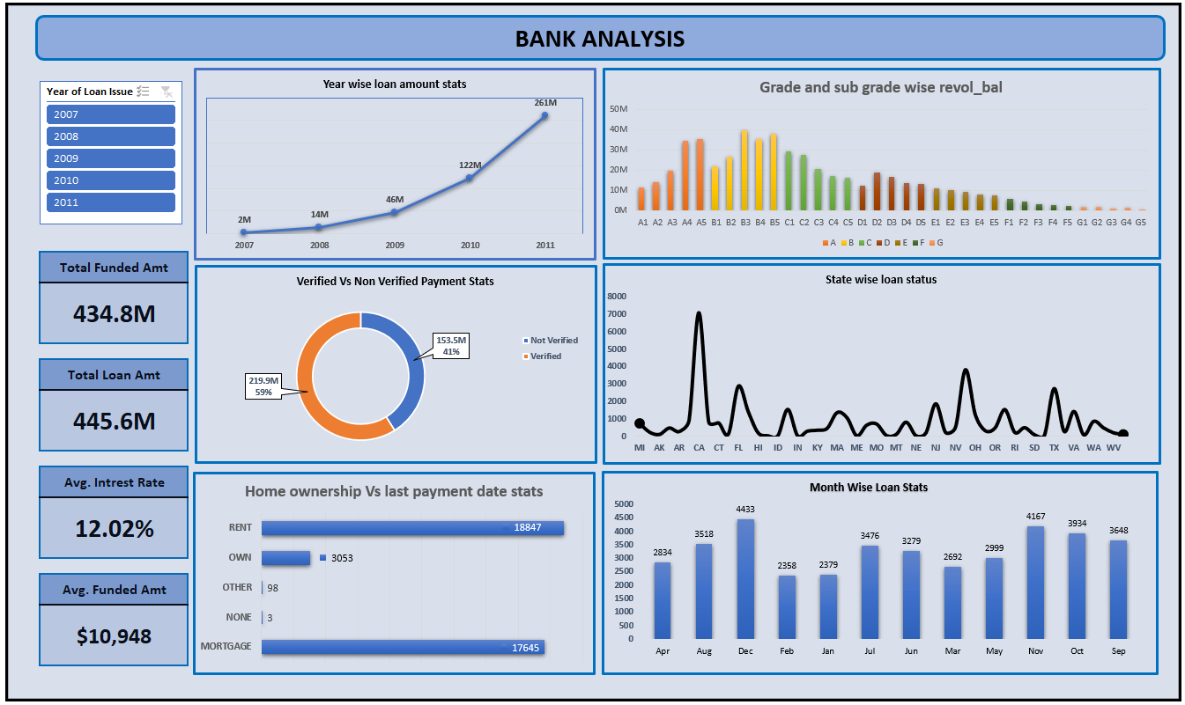
EXCEL DASHBOARD

Slide 8
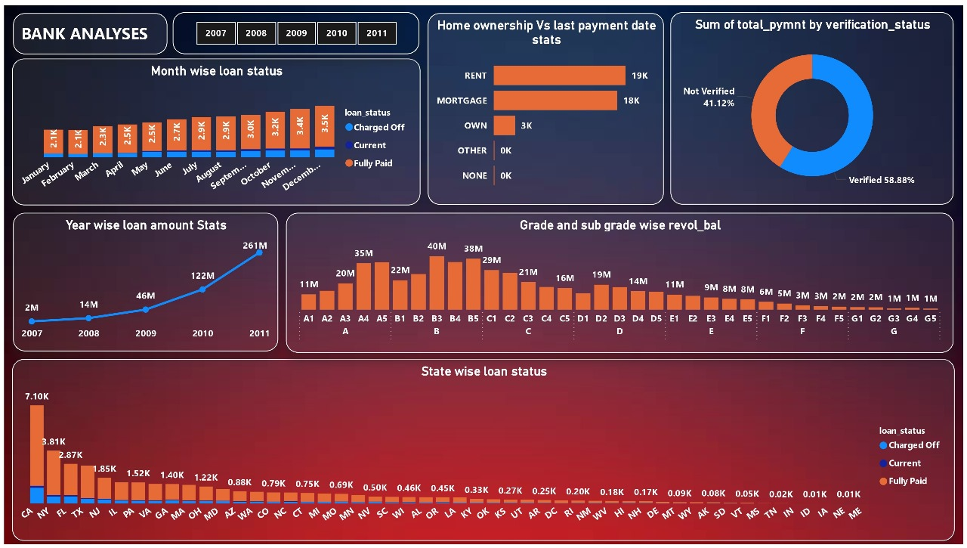
POWER BI - DASHBOARD

Slide 9
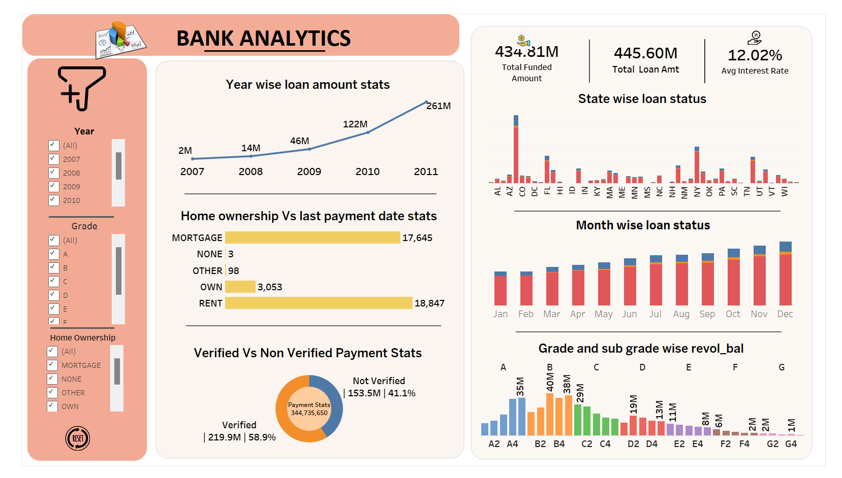
TABLEAU DASHBOARD

Slide 10

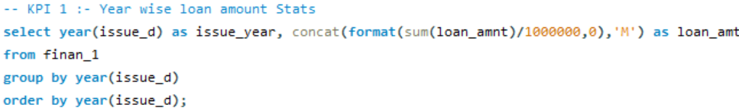
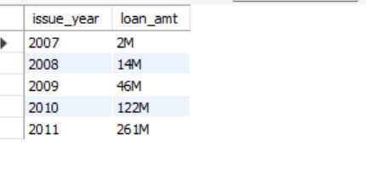
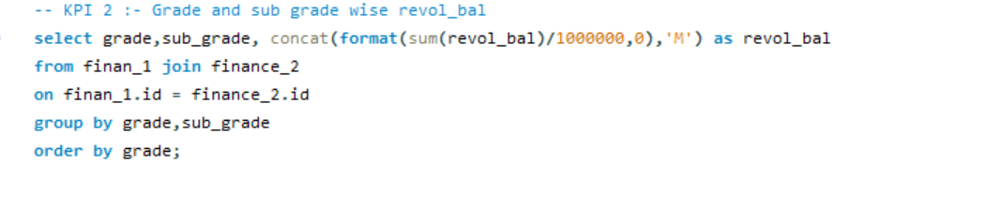
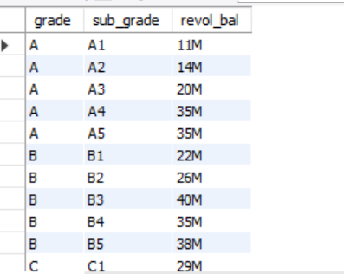
Concept Used:- “From”, “Group by”, “Order by”, “Where” and “ON” clause, “Concat” function, Joins, “Format” function, “Sum” and “Count” Function, “MonthName” Function, Alias

Slide 11
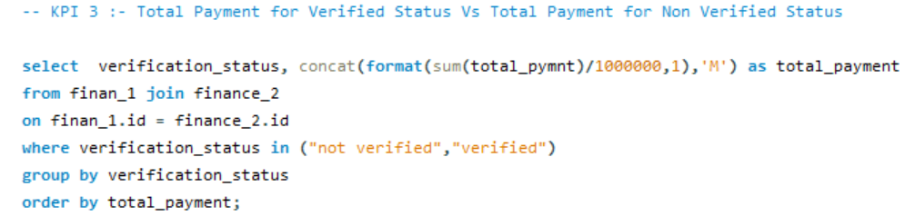
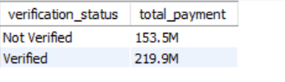
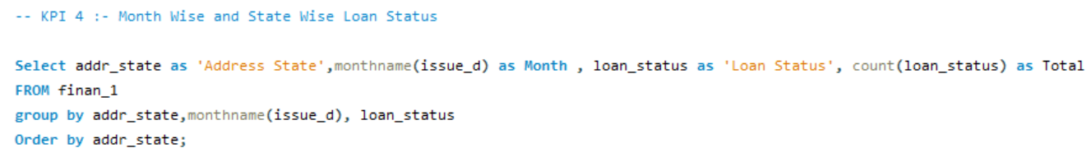
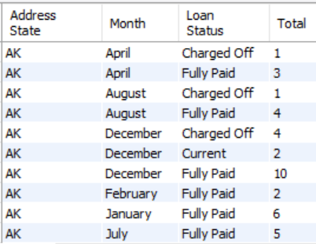

Slide 12
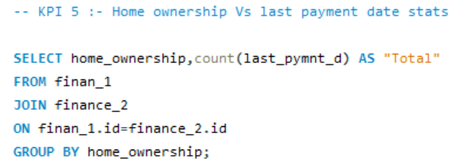
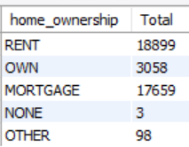

Slide 13
Increase Loan Verification:
Expand to New States:
Focus on High-Potential Borrowers:
Monitor and Optimize Loan Grades:
Boost Loans in Under-Represented Grades:
Leverage Top-Performing States:
Implement Early Warning Systems:
SUGGESTIONS FOR BUSINESS GROWTH

Slide 14
CONCLUSION
1. How to implement the ETL process which is Extract Transform & Load and also handled a huge dataset with 39000 + records.
2. Drawing meaningful insights from the data and presenting it.
3. Understanding of the features and USP of each of the software.
4. Importance of Teamwork.

